Slide 1





Hand Gesture Recognition System Enabling Real-Time Interaction Through Hand Movements
Notes:
1.7.2013
‹#›

Slide 2
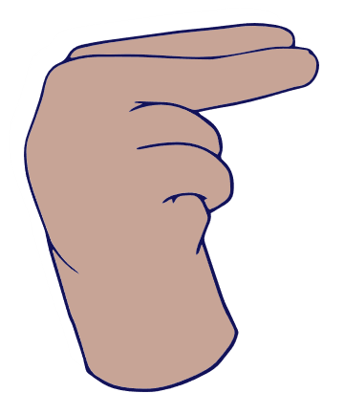

OUR TEAM
Aya Ashraf
Tasnim Qutb
Mohammed Saied
Mohammed Osama
Ahmed Barakat
Notes:
1.7.2013
‹#›

Slide 3


AGENDA
Conclusion
ML Flow
Demo & Applications
Overview
Introduction

Slide 4
TABLE OF CONTENTS
01.
02.
Introduction & Objectives
Data & Model Overview
03.
Real-Time Demo & Applications
Project idea, goals, and its importance for real-time interaction and accessibility .
Dataset collection, preprocessing, model architecture, and performance .
Live demonstration and practical uses like device control and VR .
04.
MLflow Workflow
05.
Conclusion
Tracking training runs, storing results, and preparing the model for deployment.
Key challenges, suggested improvements, and project impact .
Notes:
1.7.2013
‹#›

Slide 5
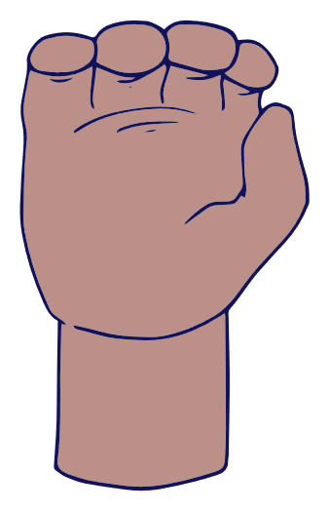
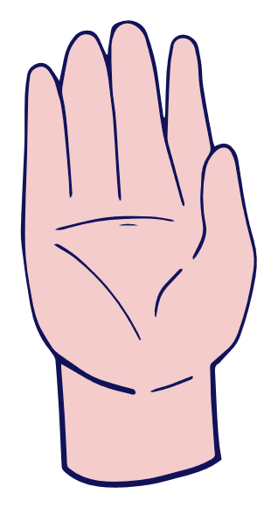
01.
Introduction & Objectives
Notes:
1.7.2013
‹#›

Slide 6

INTRODUCTION
Real-time detection: Captures hand gestures as they happen .
Gesture translation: Converts hand movements into computer/device commands.
Applications:
- Control programs or devices.
- Display content.
- Assist people with speech difficulties.
Notes:
1.7.2013
‹#›

Slide 7

Objectives :
Accurately recognize hand gestures in real-time.
Enable users to interact with devices without using a keyboard or mouse.
Practical applications in :
Human-Computer Interaction (HCI) .
Virtual Reality (VR).
Accessibility for people with speech difficulties .
Facilitate communication for people with speech impairments using gestures.
Notes:
1.7.2013
‹#›

Slide 8
02.
Data & Model Overview
Notes:
1.7.2013
‹#›

Slide 9
SEQUENCE
Data Collection
Data Preprocessing
Model Selection
Model Architecture
Model Training
Notes:
1.7.2013
‹#›

Slide 10

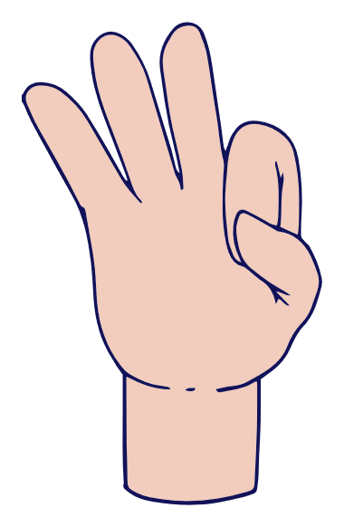
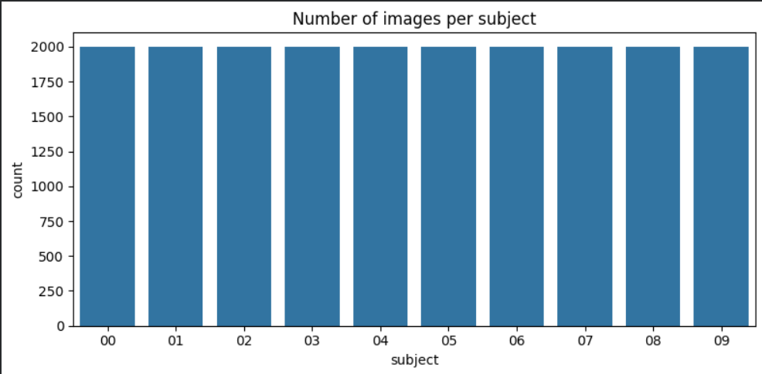
Data Collection
- Dataset: Hand Gesture Recognition Database
Data Preprocessing
- Data Augmentation
- Normalize pixel values (scale 0–1)
- Simple Data Visualization
Notes:
1.7.2013
‹#›

Slide 11

Model Selection
- A Convolutional Neural Network (CNN) was selected for handling the gesture image classification task.
Model Training
Optimizer: Adam with learning rate 0.0008
Loss function: Categorical Crossentropy
Metrics: Accuracy
Epochs: 15
Batch size: 64
Data Augmentation: rotation, zoom, width/height shift, shear, horizontal flip
Callbacks: EarlyStopping (patience=7, restore best weights), ReduceLROnPlateau (patience=3, factor=0.3, min_lr=1e-6)
Validation: monitored on validation set during training
Output: trained CNN model ready for evaluation
Notes:
1.7.2013
‹#›

Slide 12
Model Architecture
Layer Type | Filters / Units | Kernel / Size | Activation | Dropout
Conv2D | 32 | 3x3 | ReLU | 0.25
Conv2D | 32 | 3x3 | ReLU | -
MaxPooling2D | - | 2x2 | - | -
Conv2D | 64 | 3x3 | ReLU | 0.30
Conv2D | 64 | 3x3 | ReLU | -
MaxPooling2D | - | 2x2 | - | -
Conv2D | 128 | 3x3 | ReLU | 0.40
Conv2D | 128 | 3x3 | ReLU | -
MaxPooling2D | - | 2x2 | - | -
Dense | 256 | - | ReLU | 0.50
Dense (Output) | num_classes | - | Softmax | -
Notes:
1.7.2013
‹#›

Slide 13
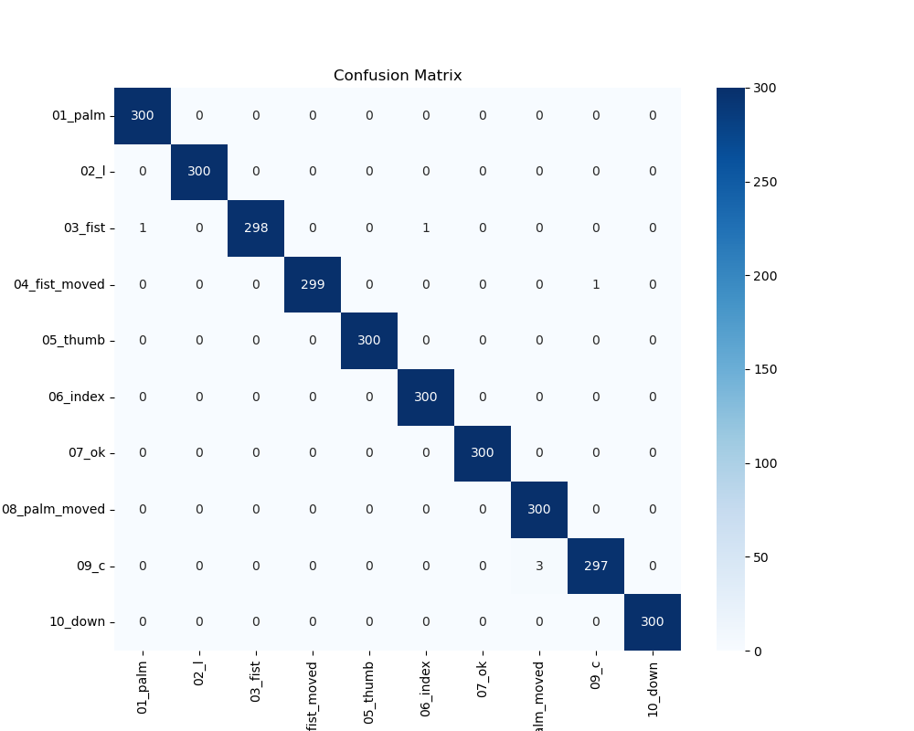
Confusion matrix to show correct and incorrect predictions
Notes:
1.7.2013
‹#›

Slide 14
03.
Real-Time Demo & Applications
Notes:
1.7.2013
‹#›

Slide 15
Real-Time Demo & Applications
-Capture live hand gestures using a camera
-Predict gestures in real-time with the trained model
Practical applications:
- Control a mouse or presentations .
- Interact with VR environments .
- Accessibility tools for people with speech difficulties .
Notes:
1.7.2013
‹#›

Slide 16
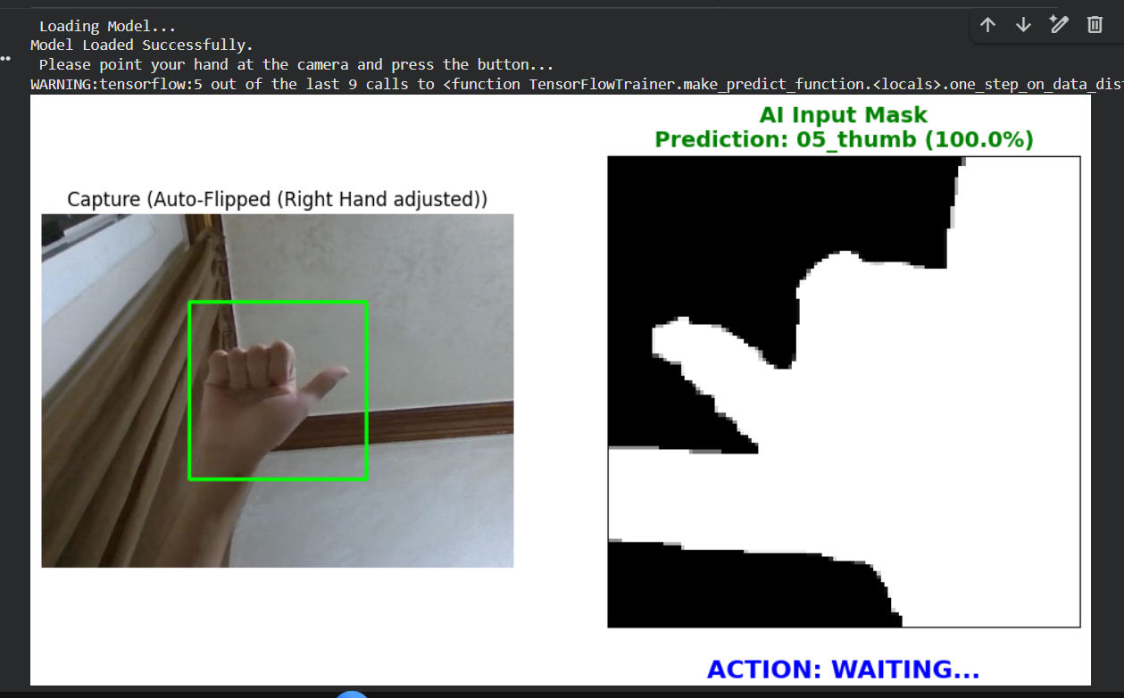
Real-Time Demo & Applications
Notebook trial:

Slide 17
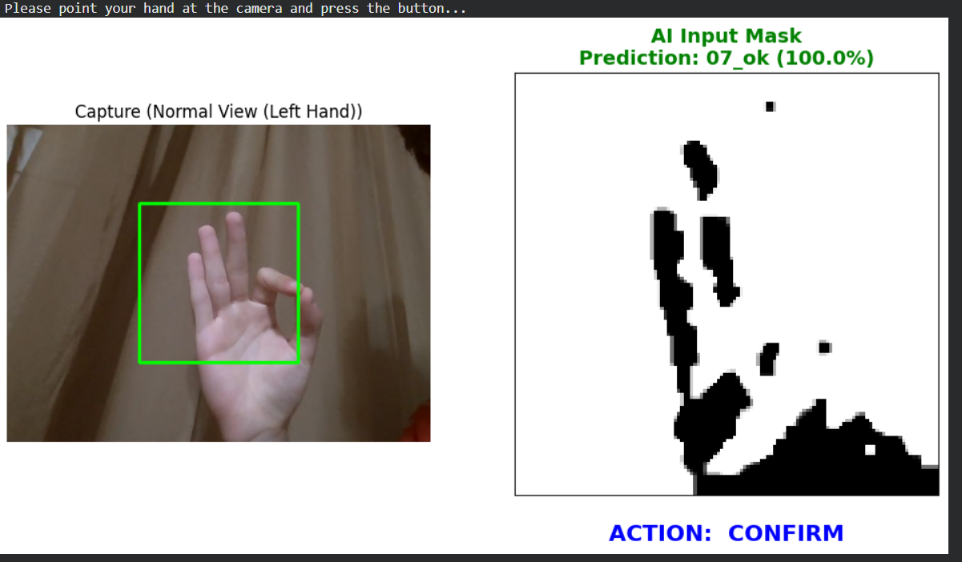
Real-Time Demo & Applications
Notebook trial:

Slide 18
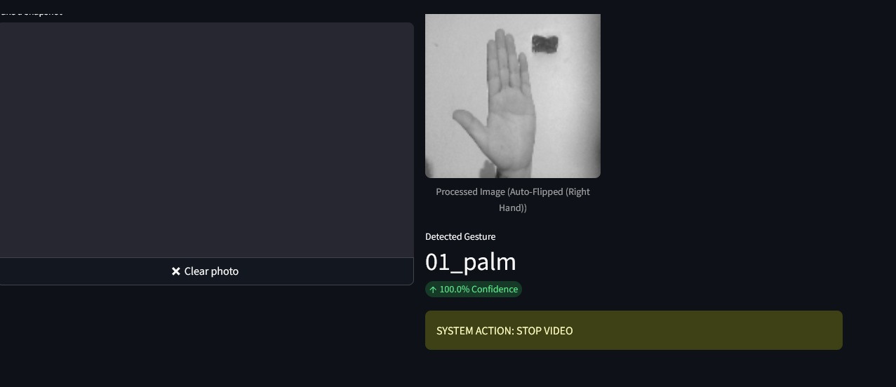
Real-Time Demo & Applications
Streamlit app trial:

Slide 19
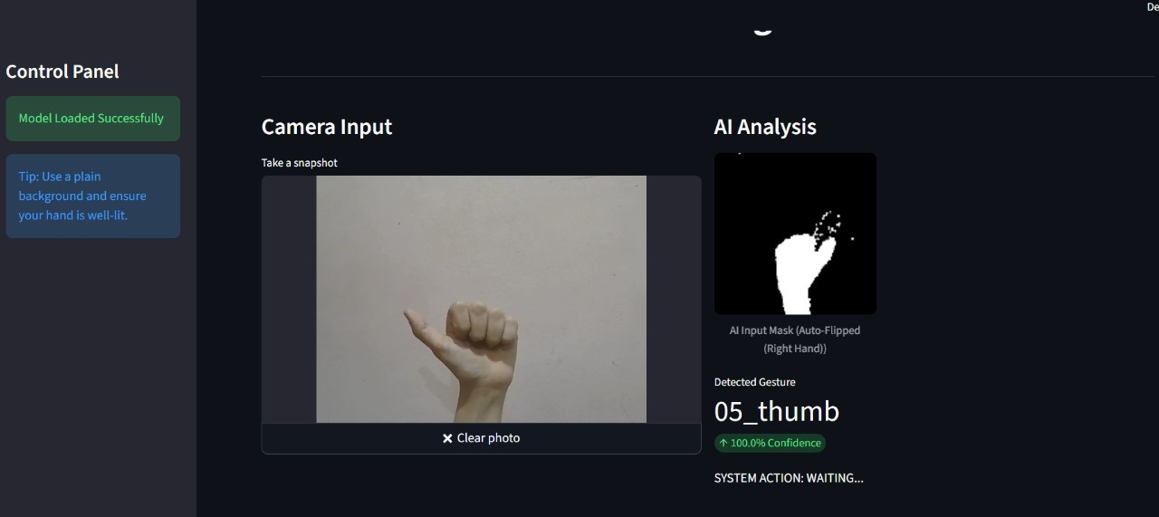
Real-Time Demo & Applications
Streamlit app trial:

Slide 20
Video

Slide 21
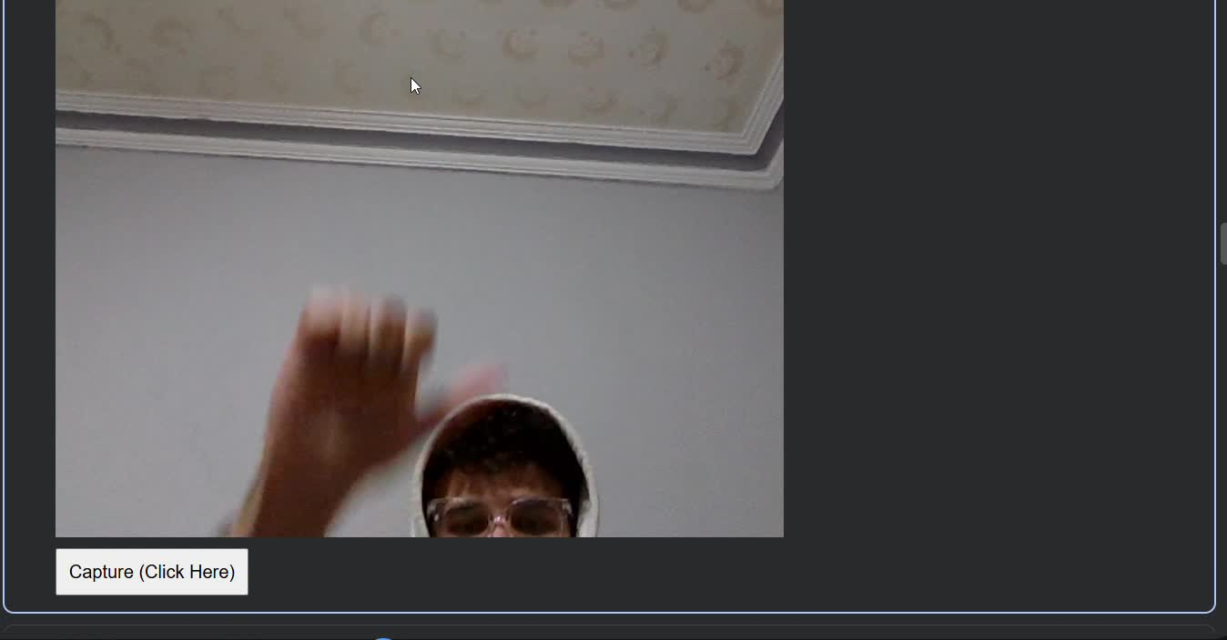

Slide 22

04.
ML FLOW WORKFLOW OVERVIEW
Notes:
1.7.2013
‹#›

Slide 23
Mlflow for Hand Gesture Recognition with CNN
Integrating MLflow for reproducible experiment tracking.
Goal
Approach
Dataset
Reproducible ML workflow.
CNN + MLflow tracking
LeapGestRecog(10 gestures)

Slide 24
Dataset & Preprocessing
LeapGestRecog Dataset
Preprocessing Steps
20,000 images
Resized to 128x128
10 gesture classes
Normalized [0, 1]
10 subjects
One-hot encoded labels
Grayscale images
Stratified split: 70% Train, 15% Val, 15% Test
Data Augmentation
Keras ImageDataGenerator for robustness (rotations, shifts, zooms, shears, horizontal flips).

Slide 25
CNN Model & Training
Convolutional Blocks
Dense Layers
Output Layer
3 blocks: Conv (ReLU), Batch Norm, Max Pooling, Dropout.
Flatten, Dense (256 units, ReLU), Batch Norm, Dropout (0.5).
Dense (10 units, Softmax) for gesture probabilities.
Optimizer
Adam (lr = 0.0008)
Loss
Categorical crossentropy
Metric
Accuracy
Epochs
15

Slide 26
MLflow Integration & Results
Parameters Logged
Metrics Logged
Artifacts Logged
Image size, batch size, epochs, optimizer, learning rate, and model architecture.
Train/Validation/Test Accuracy & Loss.
Confusion matrix, classification report, label mappings, trained Keras model

Slide 27
95% Test Accuracy !!!!
Strong performance after 15 epochs.
MLflow enables reproducibility, comparison, and debugging.
This run serves as a solid baseline for future hyperparameter exploration and model deployment.

Slide 28
05.
Challenges, Future Improvements & Conclusion
Notes:
1.7.2013
‹#›

Slide 29



Challenges
01.
02.
03.
Limited Dataset
Variations
Real-Time Performance
Not enough examples for all gestures
Different hand positions, lighting, and backgrounds
Maintaining fast and accurate recognition
Notes:
1.7.2013
‹#›

Slide 30
Future Improvements
Accessibility Applications
Integration with VR/AR
Expand Dataset
Add more hand gestures and real-world variations for better accuracy.
Apply gesture recognition in virtual or augmented reality environments.
Help people with speech or mobility difficulties communicate more easily.
Improve Real-Time Performance
Use Advanced Models
Cross-Platform Compatibility
Optimize the model to reduce latency and run faster on live video.
Experiment with newer pre-trained models for improved feature extraction
Make the system work on multiple devices and operating systems for wider accessibility.
Notes:
1.7.2013
‹#›

Slide 31


Conclusion
Recognizes hand gestures in real-time.
Enables device control and assists people with speech difficulties.
Utilizes deep learning and computer vision .
Can be improved for greater speed, accuracy, and wider applications.
Notes:
1.7.2013
‹#›

Slide 32
THANK YOU !!

